Slide 1
Chapter 4
Defining the Project

Slide 2
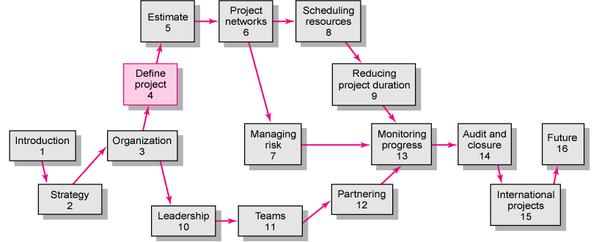
Copyright © 2006 The McGraw-Hill Companies. All rights reserved.
McGraw-Hill/Irwin 4–<number>

Slide 3
“We can control only what we have planned”
Copyright © 2006 The McGraw-Hill Companies. All rights reserved.
McGraw-Hill/Irwin 4–<number>
Notes:
PM in charge of a single small project can plan and schedule the project tasks without much formal planning and information.
However, when the project manager must manage several small projects or a large complex project, a threshold is quickly reached in which the PM can no longer cope with the detail.
Benjamin Franklin “If you fail to plan, you are planning to fail” – one of Founding Fathers of the United States
The old saying “We can control only what we have planned” is true → defining the project is the 1st step.

Slide 4
Defining the Project
Step 1: Defining the Project Scope
Step 2: Establishing Project Priorities
Step 3: Creating the Work Breakdown Structure
Step 4: Integrating the WBS with the Organization
Step 5: Coding the WBS for the Information System
Project Communication Plan
Copyright © 2006 The McGraw-Hill Companies. All rights reserved.
McGraw-Hill/Irwin 4–<number>
Notes:
This early phase of the project is going to go through 5 steps.
WBS → A disciplined, structured method THAT help outline the project → this outline will ensure that all tasks are identified and that participants of the project have an understanding of what is to be done.
With the work of the project defined through WBS, the chapter concludes with the process of creating a communication plan used to help coordinate project activities and follow progress.

Slide 5
Step 1: Defining the Project Scope
Project Scope
  A definition of the end result or mission of the project—a product or service for the client/customer—in specific, tangible, and measurable terms.
Purpose of the Scope Statement
  To clearly define the deliverable(s) for the end user.
  To focus the project on successful completion of its goals.
  To be used by the project owner and participants as a planning tool and for measuring project success.
Copyright © 2006 The McGraw-Hill Companies. All rights reserved.
McGraw-Hill/Irwin 4–<number>
Notes:
A SCOPE describes what you expect to deliver to your customer when the project is complete. It should define the results to be achieved in specific, tangible, and measurable terms.

Slide 6

Project Scope Checklist
Project objective
Deliverables
Milestones
Technical requirements
Limits and exclusions
Reviews with customer
Copyright © 2006 The McGraw-Hill Companies. All rights reserved.
McGraw-Hill/Irwin 4–<number>
Notes:
Clearly, project scope is the keystone interlocking all elements of a project plan. To ensure that scope definition is complete, you may wish to use the PROJECT SCOPE CHECKLIST
Objectives → answer the questions WHAT, WHEN, and HOW MUCH
Deliverables → expected outputs over the project life cycle → early phase, second phase,… results
Milestones → a significant event of the project at a point in time
Technical requirements → to ensure the proper performance → system requirements for the desktop installed
Limits and exclusions
Reviews with your customer → either internal or external

Slide 7
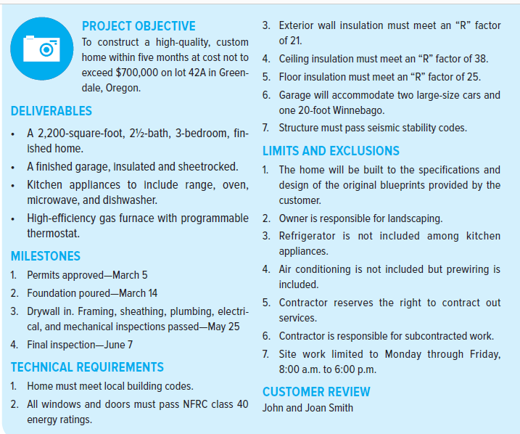
Project Scope Checklist
Copyright © 2006 The McGraw-Hill Companies. All rights reserved.
McGraw-Hill/Irwin 4–<number>
Notes:
As brief as possible but complete, typical 1-2 pages for small projects

Slide 8
Project Scope: Terms and Definitions
Scope Statements
  Also called statements of work (SOW)
Project Charter
  Can contain an expanded version of scope statement
  A document authorizing the project manager to initiate and lead the project.
Project Creep
  The tendency for the project scope to expand over time due to changing requirements, specifications, and priorities.
Copyright © 2006 The McGraw-Hill Companies. All rights reserved.
McGraw-Hill/Irwin 4–<number>

Slide 9
Step 2: Establishing Project Priorities
Causes of Project Trade-offs
  Shifts in the relative importance of criterions related to cost, time, and performance parameters
    Budget–Cost
    Schedule–Time
    Performance–Scope
Managing the Priorities of Project Trade-offs
  Constrain: a parameter is a fixed requirement.
  Enhance: optimizing a parameter over others.
  Accept: reducing (or not meeting) a parameter requirement.
Copyright © 2006 The McGraw-Hill Companies. All rights reserved.
McGraw-Hill/Irwin 4–<number>

Slide 10
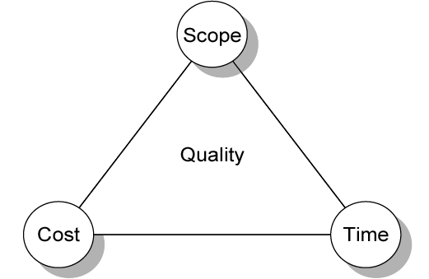
Project Management Trade-offs
FIGURE 4.1
Copyright © 2006 The McGraw-Hill Companies. All rights reserved.
McGraw-Hill/Irwin 4–<number>

Slide 11
Project Management Trade-offs
Cost
Scope
Time
Copyright © 2006 The McGraw-Hill Companies. All rights reserved.
McGraw-Hill/Irwin 4–<number>
Notes:
If some of the project conditions get better
If some of the project conditions get worse

Slide 12
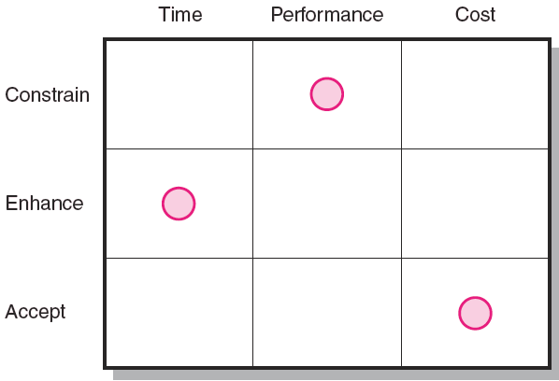
Project Priority Matrix
FIGURE 4.2
Copyright © 2006 The McGraw-Hill Companies. All rights reserved.
McGraw-Hill/Irwin 4–<number>
Notes:
Illustrate the priority matrix for the development of a new wireless modem
→ time to market is important to sales
→ original performance spec. & reliability standards cannot be compromised
→ not desire, but can accept cost increasing

Slide 13
Step 3: Creating the Work
Breakdown Structure
Work Breakdown Structure (WBS)
  An hierarchical outline (map) that identifies the products and work elements involved in a project.
  Defines the relationship of the final deliverable (the project) to its sub-deliverables, and in turn, their relationships to work packages.
  Best suited for design and build projects that have tangible outcomes rather than process-oriented projects.
Copyright © 2006 The McGraw-Hill Companies. All rights reserved.
McGraw-Hill/Irwin 4–<number>

Slide 14
Process Breakdown Structure
Process-Oriented Projects
  Are driven by performance requirements in which the final outcome is the product of a series of steps of phases in which one phase affects the next phase.
Process Breakdown Structure (PBS)
  Defines deliverables as outputs required to move to the next phase .
  Checklists for managing PBS:
    Deliverables needed to exit one phase and begin the next.
    Quality checkpoints for complete and accurate deliverables.
    Sign-offs by responsible stakeholders to monitor progress.
Copyright © 2006 The McGraw-Hill Companies. All rights reserved.
McGraw-Hill/Irwin 4–<number>
Notes:
Now before we go to create one WBS for your project, let I introduce to you some concepts related to A PROCESS ORIENTED PROJECT
PBS is used for projects that customers are not really know what they want.
Try to break the project into phases

Slide 15
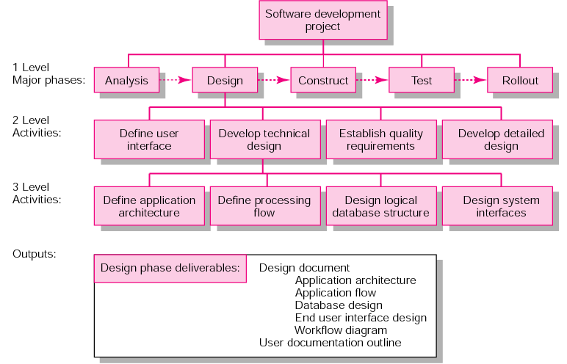
PBS for Software Project Development
FIGURE 4.8
Copyright © 2006 The McGraw-Hill Companies. All rights reserved.
McGraw-Hill/Irwin 4–<number>

Slide 16
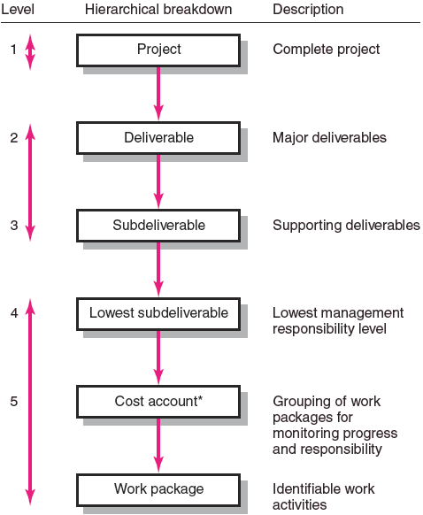
Hierarchical Breakdown of the WBS
FIGURE 4.3
Copyright © 2006 The McGraw-Hill Companies. All rights reserved.
McGraw-Hill/Irwin 4–<number>
Notes:
The process continues until sub-deliverable detail is small enough to be manageable and where one person can be responsible
WP are grouped by type of work → the grouping facilitates a system for monitoring project progress by work, cost, responsibility

Slide 17
How WBS Helps the Project Manager
WBS
  Facilitates evaluation of cost, time, and technical performance of the organization on a project.
  Provides management with information appropriate to each organizational level.
  Helps in the development of the organization breakdown structure (OBS). which assigns project responsibilities to organizational units and individuals
  Helps manage plan, schedule, and budget.
  Defines communication channels and assists in coordinating the various project elements.
Copyright © 2006 The McGraw-Hill Companies. All rights reserved.
McGraw-Hill/Irwin 4–<number>

Slide 18
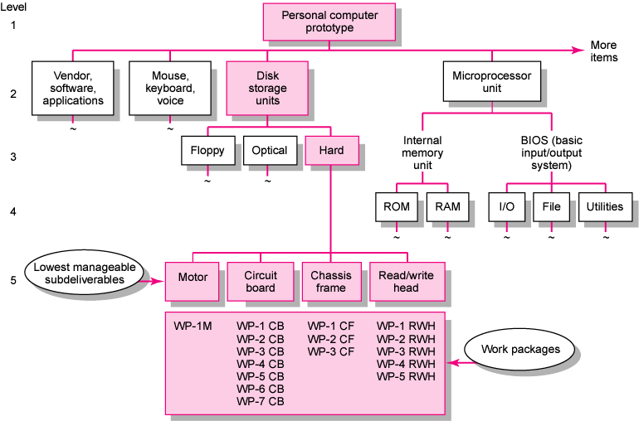
Work Breakdown Structure
FIGURE 4.4
Copyright © 2006 The McGraw-Hill Companies. All rights reserved.
McGraw-Hill/Irwin 4–<number>
Notes:
Some of WPs, which have same type of work, might be grouped into a cost account

Slide 19
Work Packages
A work package is the lowest level of the WBS.
  It is output-oriented in that it:
    Defines work (what).
    Identifies time to complete a work package (how long)
    Identifies a time-phased budget to complete a work package (cost)
    Identifies resources needed to complete a work package (how much)
    Identifies a single person responsible for units of work (who)
    Identifies monitoring points (milestones) for measuring success.
Copyright © 2006 The McGraw-Hill Companies. All rights reserved.
McGraw-Hill/Irwin 4–<number>
Notes:
To review, each work package have to answer 6 questions, which are related to what, how long, cost, how much, who, how well.

Slide 20
Step 4: Integrating the WBS
with the Organization
Organizational Breakdown Structure (OBS)
  Depicts how the firm is organized to discharge its work responsibility for a project.
    Provides a framework to summarize organization work unit performance.
    Identifies organization units responsible for work packages.
    Ties the organizational units to cost control accounts.
Copyright © 2006 The McGraw-Hill Companies. All rights reserved.
McGraw-Hill/Irwin 4–<number>
Notes:
WBS is used to link the org. units responsible for performing the work → the outcome of this process is the OBS

Slide 21
Work Breakdown Structure
FIGURE 4.4
Copyright © 2006 The McGraw-Hill Companies. All rights reserved.
McGraw-Hill/Irwin 4–<number>
Notes:
Some of WPs, which have same type of work, might be grouped into a cost account

Slide 22
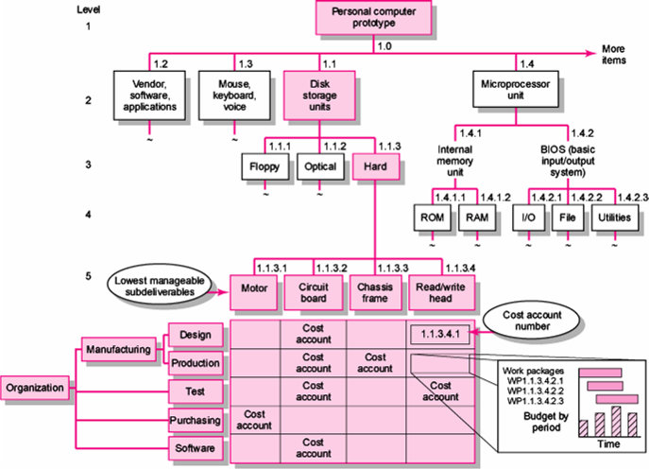
Integration of WBS and OBS
FIGURE 4.5
Copyright © 2006 The McGraw-Hill Companies. All rights reserved.
McGraw-Hill/Irwin 4–<number>
Notes:
Motor: 1 WP
Circuit board: 7 WP
Chassis frame: 3 WP
Read/write head: 5 WP
The OBS assigns the lowest org. unit the responsibility for WP within a cost account → OBS and WBS CAN BE INTEGRATED → the intersection of WP and org. unit creates a project control point (cost account).
In the executing phase, progress can tracked vertically on deliverables (client’s interest), or horizontally tracked on org. responsibility (management’s interest)

Slide 23
Project Roll-up
Cost Account
  The intersection of the WBS and the OBS that is a budgetary control point for work packages.
  Used to provide a roll-up (summation) of costs incurred over time by a work package across organization units and levels, and by deliverables.
Copyright © 2006 The McGraw-Hill Companies. All rights reserved.
McGraw-Hill/Irwin 4–<number>

Slide 24
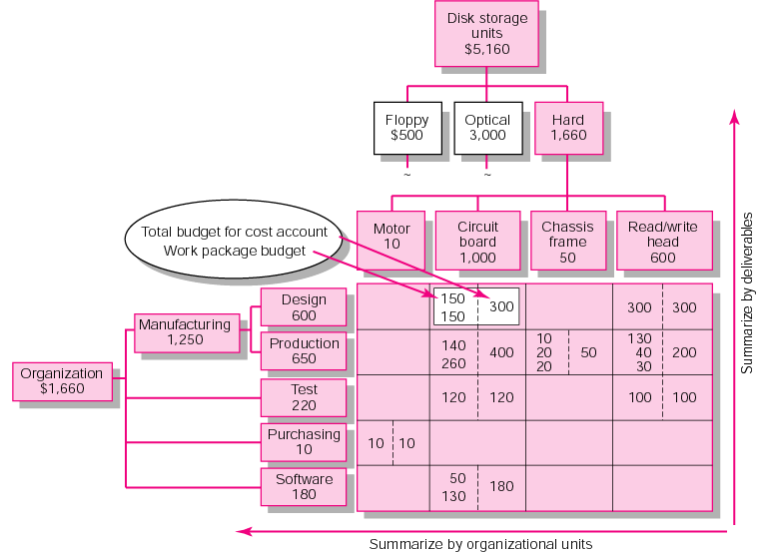
Direct Labor Budget Rollup (000)
FIGURE 4.7
Copyright © 2006 The McGraw-Hill Companies. All rights reserved.
McGraw-Hill/Irwin 4–<number>

Slide 25

Step 5: Coding the WBS
for the Information System
WBS Coding System
  Defines:
    Levels and elements of the WBS
    Organization elements
    Work packages
    Budget and cost information
  Allows reports to be consolidated at any level in the organization structure
Copyright © 2006 The McGraw-Hill Companies. All rights reserved.
McGraw-Hill/Irwin 4–<number>

Slide 26
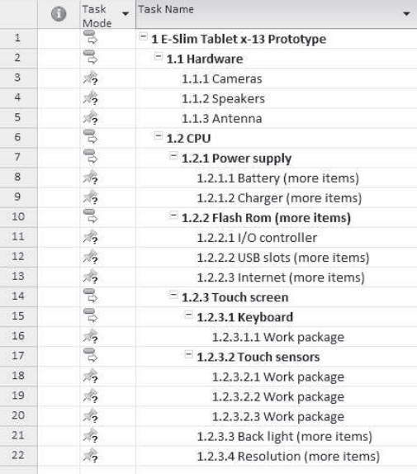
WBS Coding
Copyright © 2006 The McGraw-Hill Companies. All rights reserved.
McGraw-Hill/Irwin 4–<number>
Notes:
The most commonly used scheme in practice is numeric indention → eg, new computer project and disk storage units
The “cost account” is a focal point, because all budgets, work assignments, time, cost, and technical performance come together at this point
In practice, most companies are creative in combining number and letter to make the WBS codes as short as possible

Slide 27
Responsibility Matrices
Responsibility Matrix (RM)
  Also called a linear responsibility chart.
  Summarizes the tasks to be accomplished and who is responsible for what on the project.
    Lists project activities and participants.
    Clarifies critical interfaces between units and individuals that need coordination.
    Provide an means for all participants to view their responsibilities and agree on their assignments.
    Clarifies the extent or type of authority that can be exercised by each participant.
Copyright © 2006 The McGraw-Hill Companies. All rights reserved.
McGraw-Hill/Irwin 4–<number>

Slide 28
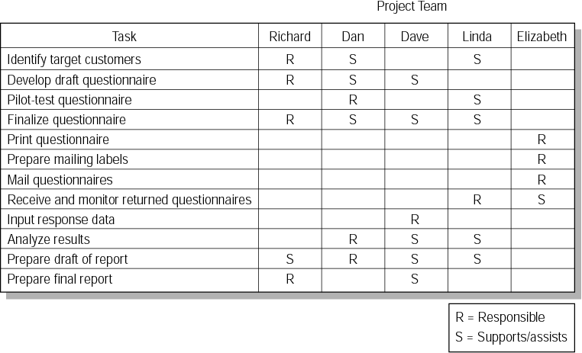
Responsibility Matrix for a Market Research Project
FIGURE 4.9
Copyright © 2006 The McGraw-Hill Companies. All rights reserved.
McGraw-Hill/Irwin 4–<number>

Slide 29
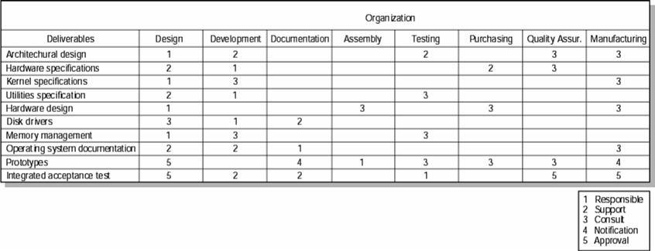
Responsibility Matrix for the Conveyor Belt Project
FIGURE 4.10
Copyright © 2006 The McGraw-Hill Companies. All rights reserved.
McGraw-Hill/Irwin 4–<number>

Slide 30
Project Communication Plan
Created by the project manager and/or project team in the early stage of project planning
Map out the flow of information to different stakeholders
  What information needs to be collected and when?
  Who will receive the information?
  What methods will be used?
  What are the limits on access?
  When and How will the information be communicated?
Copyright © 2006 The McGraw-Hill Companies. All rights reserved.
McGraw-Hill/Irwin 4–<number>
Notes:
be an integrated part of overall project plan
This plan should be followed after other activities related to deliverables and work are clearly defined. Poor communication can be a major contributor to project failure.
Establishing communication plan can control the flow of information, instead having information by requests.

Slide 31
Developing a communication plan
Stakeholder analysis
Information needs
Sources of information
Dissemination modes
Responsibility and timing
Copyright © 2006 The McGraw-Hill Companies. All rights reserved.
McGraw-Hill/Irwin 4–<number>
Notes:
Identify the target groups who needs project information to make decisions and/or contribute the project progress
Infor. Needs for each groups (different concern, different interest → their needed infor. will differ).
Where: reports, meetings…
Email, teleconferencing, Lotus Notes, SharePoint… → virtual project office to share project info. Immediately
Who will send out the information?

Slide 32
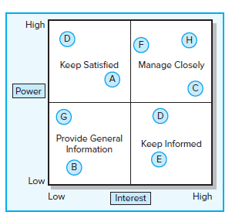
Stakeholder communications
FIGURE 4.9
Copyright © 2006 The McGraw-Hill Companies. All rights reserved.
McGraw-Hill/Irwin 4–<number>
Notes:
By identifying stakeholders and prioritizing them on the “Power/Interest” map, you can plan the type and frequency of communications needed.

Slide 33
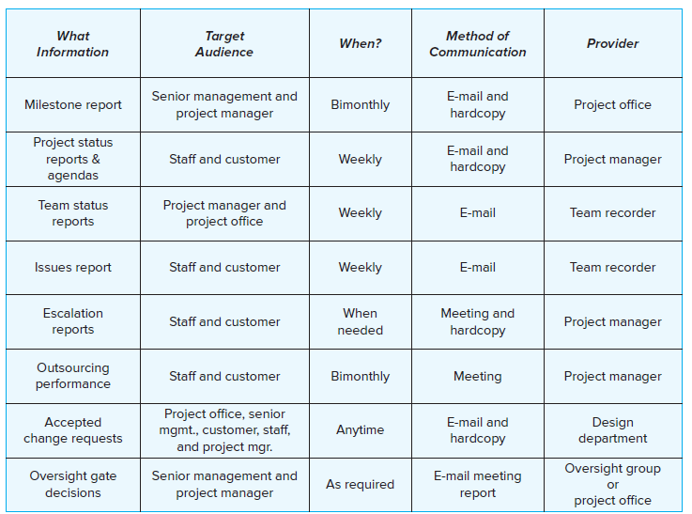
Shale Oil Research Project Communication Plan
FIGURE 4.10
Copyright © 2006 The McGraw-Hill Companies. All rights reserved.
McGraw-Hill/Irwin 4–<number>

Slide 34
Key Terms
Cost account
Milestone
Organization breakdown structure (OBS)
Scope creep
Priority matrix
Project charter
Responsibility matrix
Scope statement
Work breakdown structure (WBS)
Work package
Copyright © 2006 The McGraw-Hill Companies. All rights reserved.
McGraw-Hill/Irwin 4–<number>

Slide 35
Review
Identify real life examples of a project that would fit each of the following priority scenarios:
  Time-constrain, Scope-enhance, Cost-accept
  Time-accept, Scope-constrain, Cost-accept
  Time-constrain, Scope-accept, Cost-enhance
You are the father or mother of a family of four (kids ages 13 and 15) planning a weekend camping trip. Develop a responsibility matrix for the work that needs to be done prior to starting your trip.
Develop a communication plan for an airport security project. The project entails installing the hardware and software system that (1) scans a passenger’s eyes, (2) fingerprints the passenger, and (3) transmits the information to a central location for evaluation.
Copyright © 2006 The McGraw-Hill Companies. All rights reserved.
McGraw-Hill/Irwin 4–<number>

